Slide 1
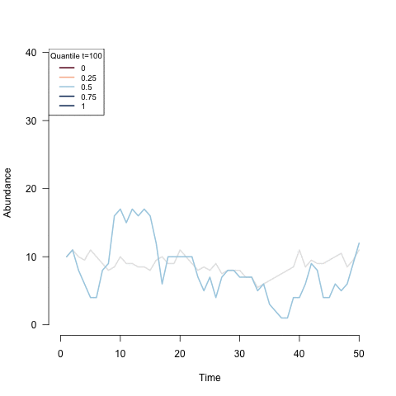

Deep-Learning
Restaurant Demand Forecasting
Carmen Pelayo Fernández
April 2024
Faculty of Computing and Data Sciences
CDS DS 598 - Deep Learning

Slide 2
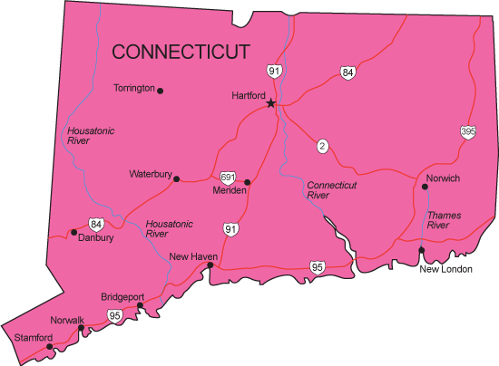
Context & Motivation
💼 Business undergrad.
🎯 Huge impact of accurate demand estimates on local businesses (to prevent unnecessary costs).
🤝 Prof. Gardos’ friend owns a café in Connecticut and has collected sales data since 2000.
Faculty of Computing and Data Sciences
Carmen Pelayo Fernández
Notes:
1 min

Slide 3
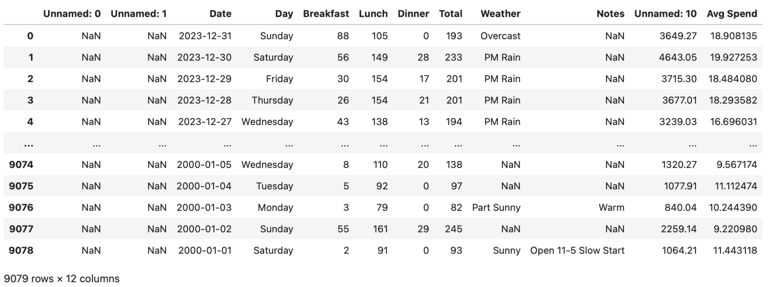
Only 22% of observations have non-blank notes
23 years of data
2. Data (Before)
Revenue
Dropped
Encoded
40 different ‘Weather’ values → Simplified into 7 categories + Encoded
Dependent variables → ‘Breakfast’ + ‘Lunch’ + ‘Dinner’ = ‘Total’
Dependent variables →
‘Total’ x ‘Avg Spend’ = ‘Revenue’
Target variable
Faculty of Computing and Data Sciences
Carmen Pelayo Fernández
Notes:
1 min

Slide 4
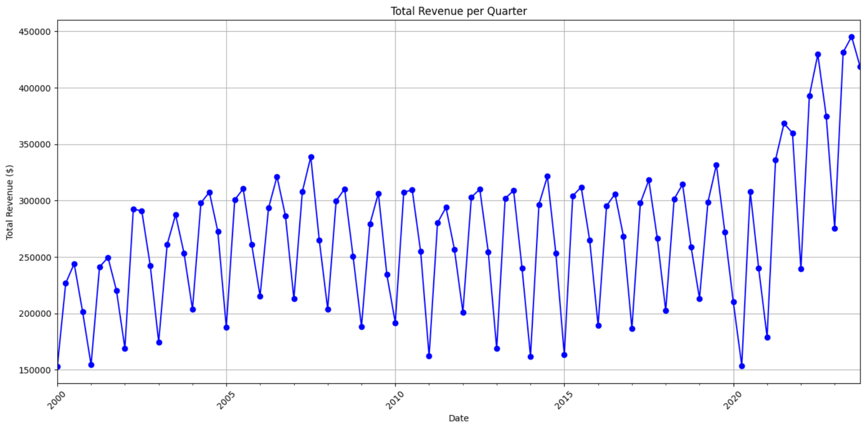
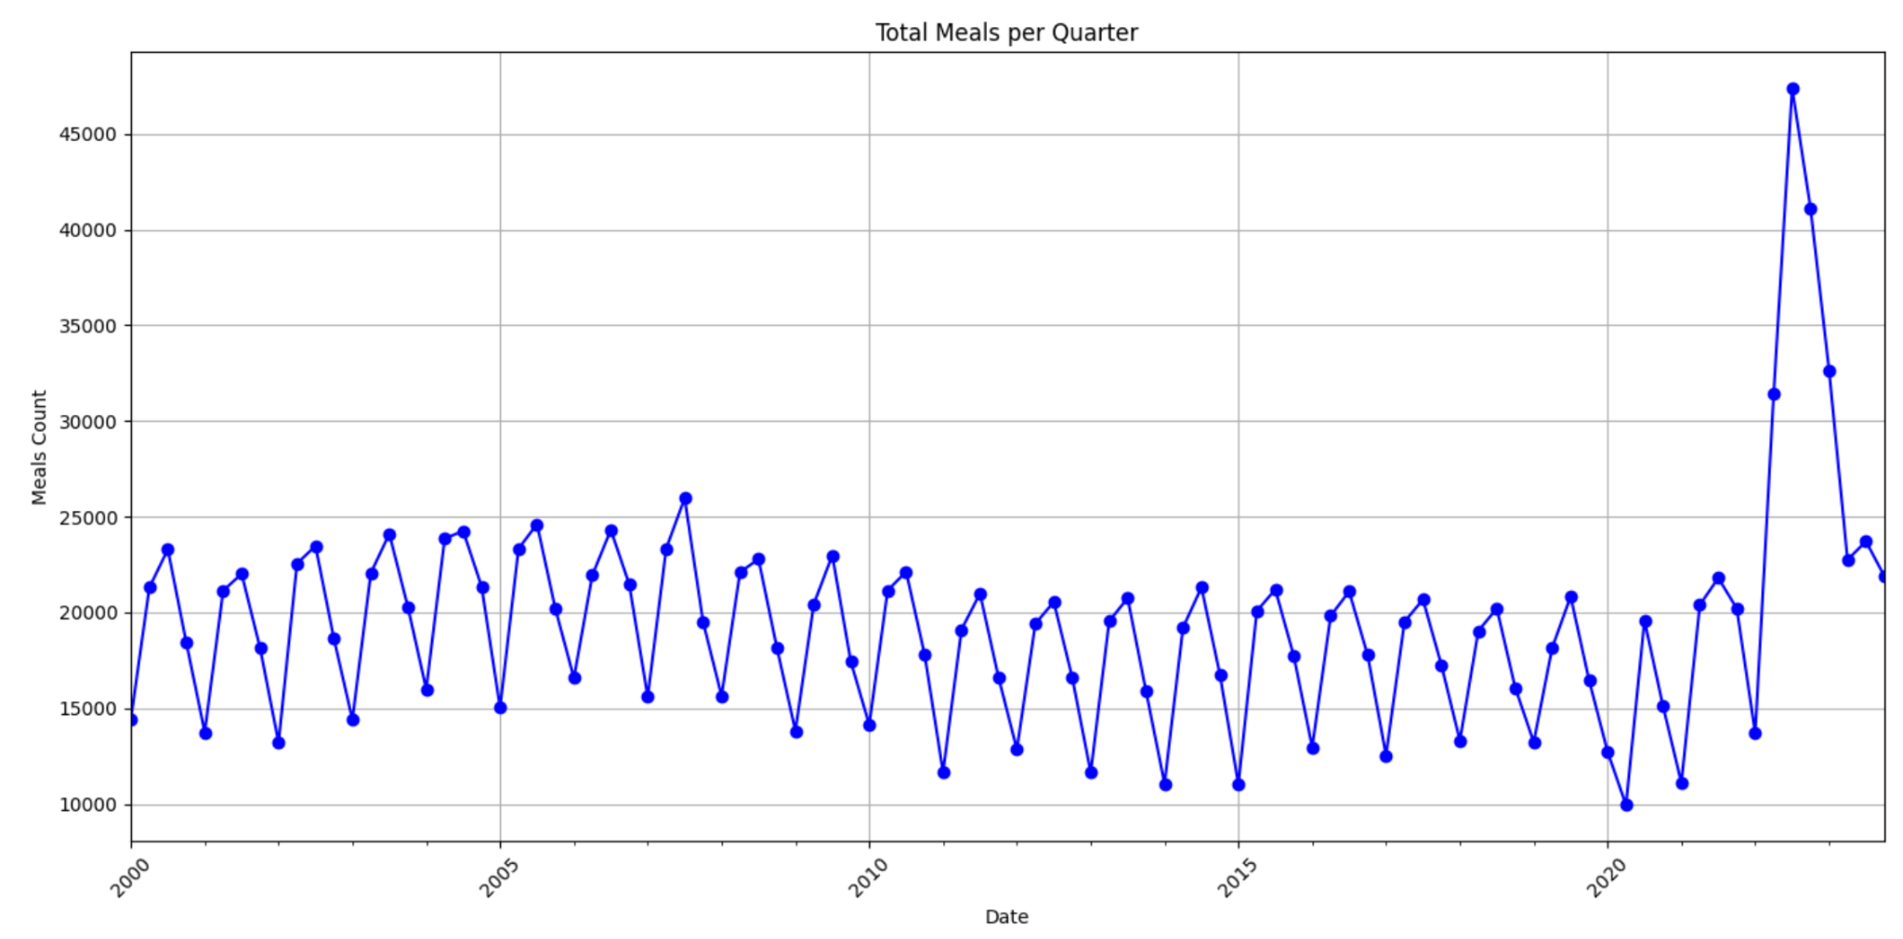
2. Data (Before)
2. Data (After)
314 duplicates in 2022 & 2023! → Dropped
⚠️ Outliers?
Missing values →
Spline interpolation
Faculty of Computing and Data Sciences
Carmen Pelayo Fernández
Notes:
1 min

Slide 5
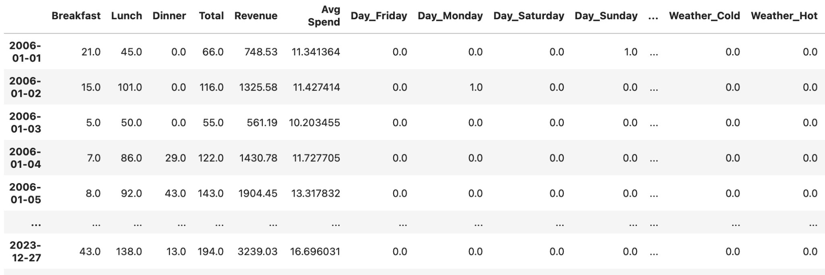
2. Data (After)
…can I get more from it?
Faculty of Computing and Data Sciences
Carmen Pelayo Fernández
Notes:
1 min

Slide 6
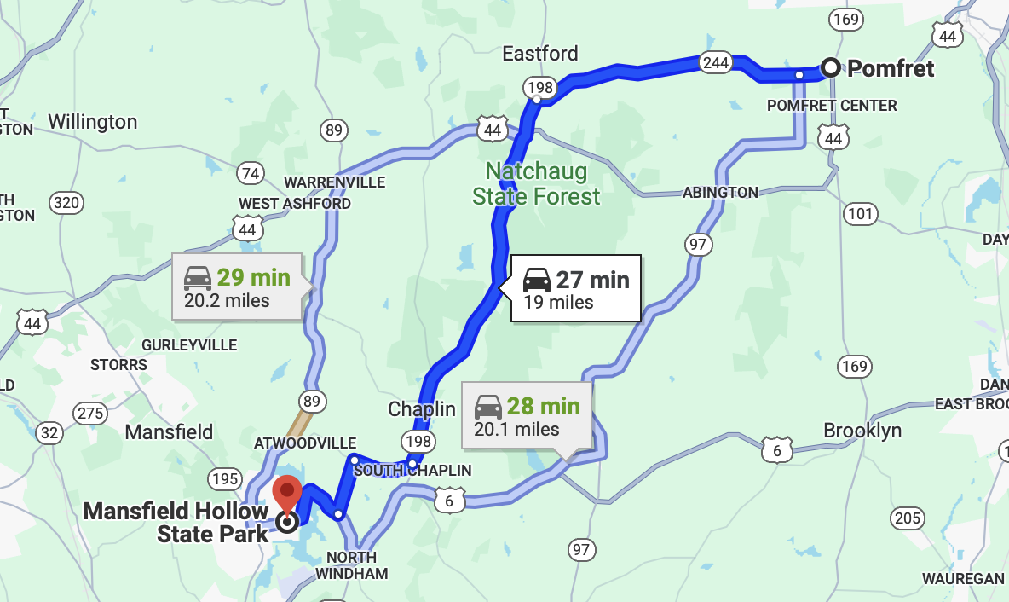

2. Data (Extra I) → Numerical Weather Data
📍
Numerical Weather Data
Temperature
Rain
Wind
⚠️ (Only after 01/01/2006)
API
Faculty of Computing and Data Sciences
Carmen Pelayo Fernández
Notes:
1 min

Slide 7
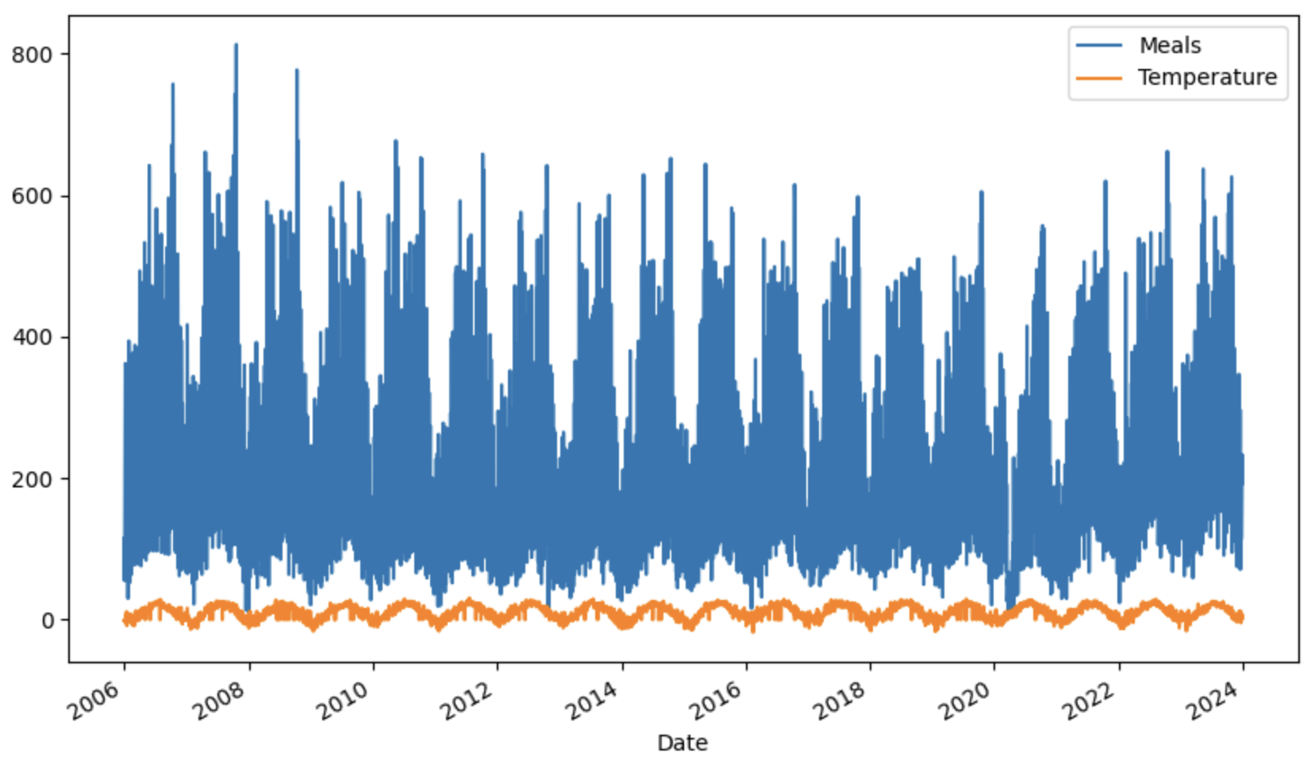
2. Data (Extra I) → Numerical Weather Data
Faculty of Computing and Data Sciences
Carmen Pelayo Fernández
Notes:
1 min

Slide 8


2. Data (Extra II) → Sentiment Scores on ‘Notes’
Valence Aware Dictionary and sEntiment Reasoner (VADER)
Sentiment lexicon (i.e., words labeled according to their semantic +/- orientation) +
set of rule-based modeling for text analysis.
Classifies text by grading each word one by one in either pos(0,1]/neg[-1,0)/neutral(=0) +
aggregates grades to get final score.
Transformers
bert-base-multilingual-uncased-sentiment → pre-trained on 150k product reviews.
bertweet-sentiment-analysis → pre-trained with ~40k tweets.
roberta-targeted-sentiment-classification-newsarticles→ pre-trained on 10k sentences
sampled from news articles, each labeled and agreed by > 5 annotators.
Faculty of Computing and Data Sciences
Carmen Pelayo Fernández
Notes:
1 min

Slide 9
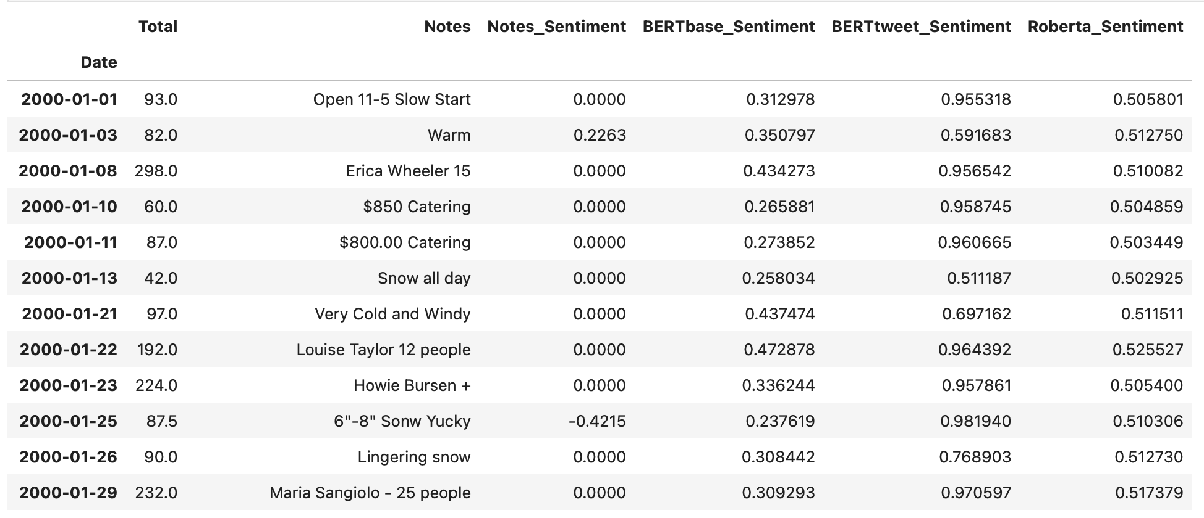
2. Data (Extra II) → Sentiment Scores on ‘Notes’
Faculty of Computing and Data Sciences
Carmen Pelayo Fernández
Notes:
1 min

Slide 10
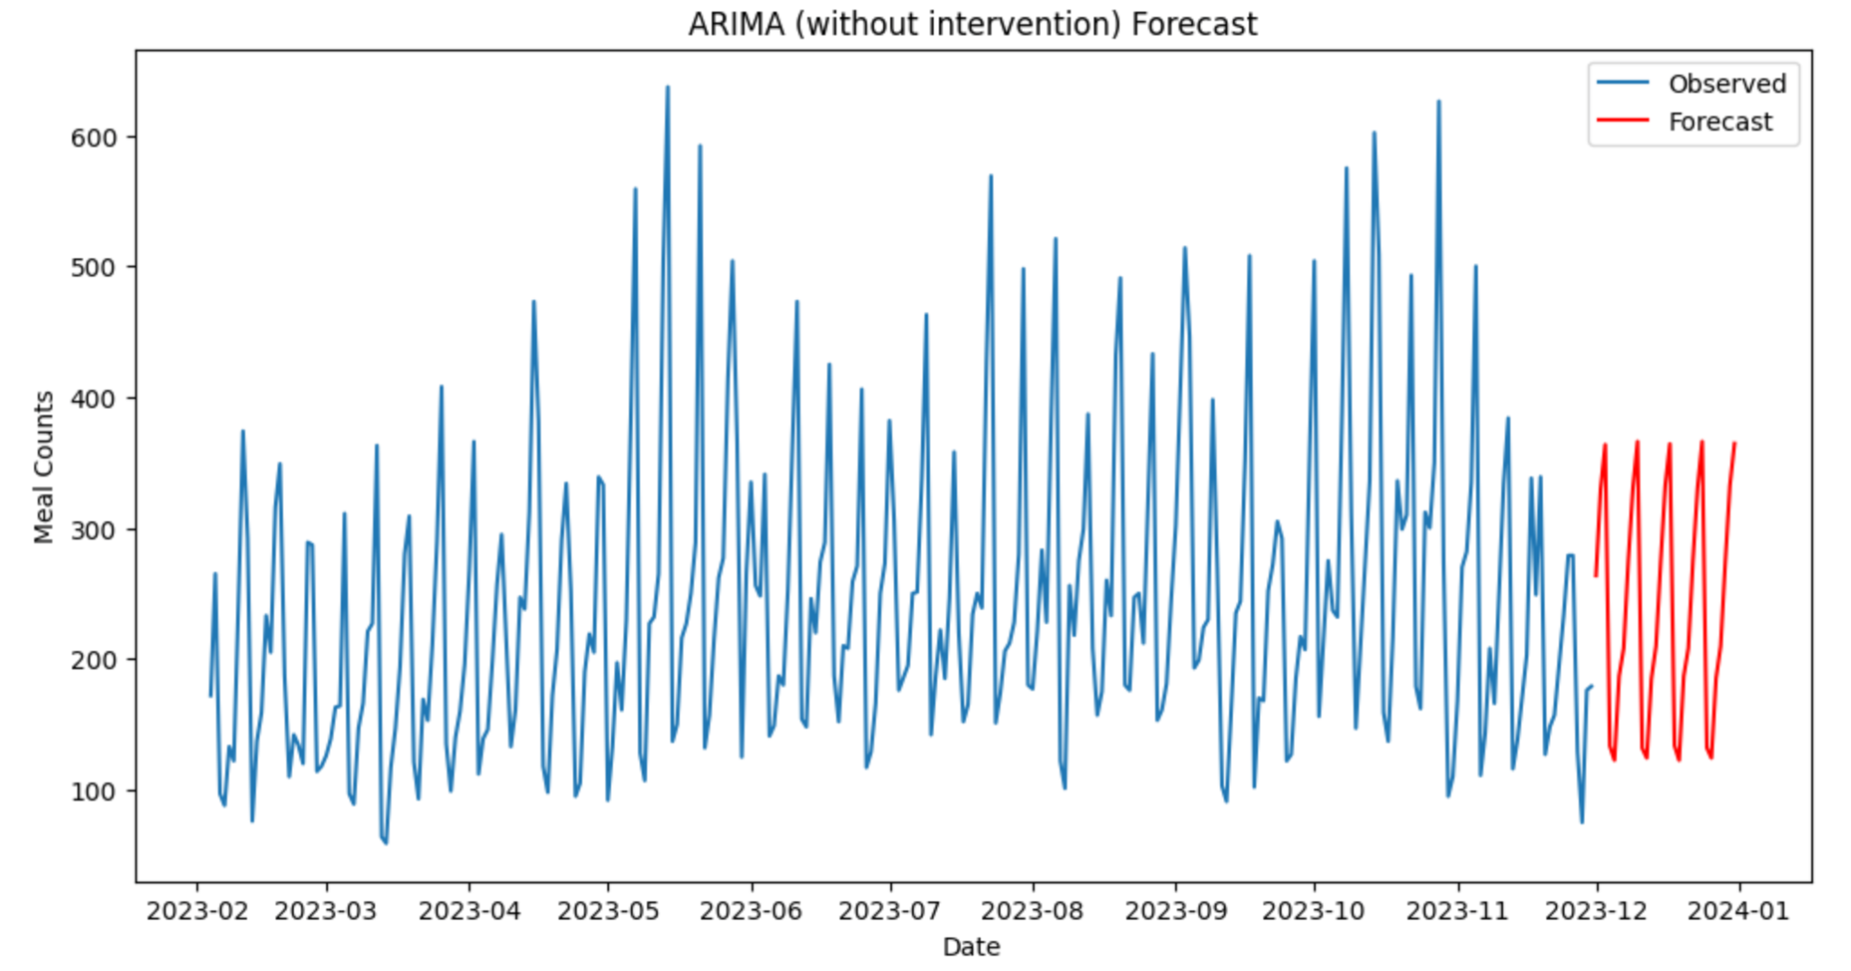
3.1. Modeling → AutoRegressive Integrated Moving Average (ARIMA)
MAPE 0.3348
Faculty of Computing and Data Sciences
Carmen Pelayo Fernández
Notes:
1 min

Slide 11
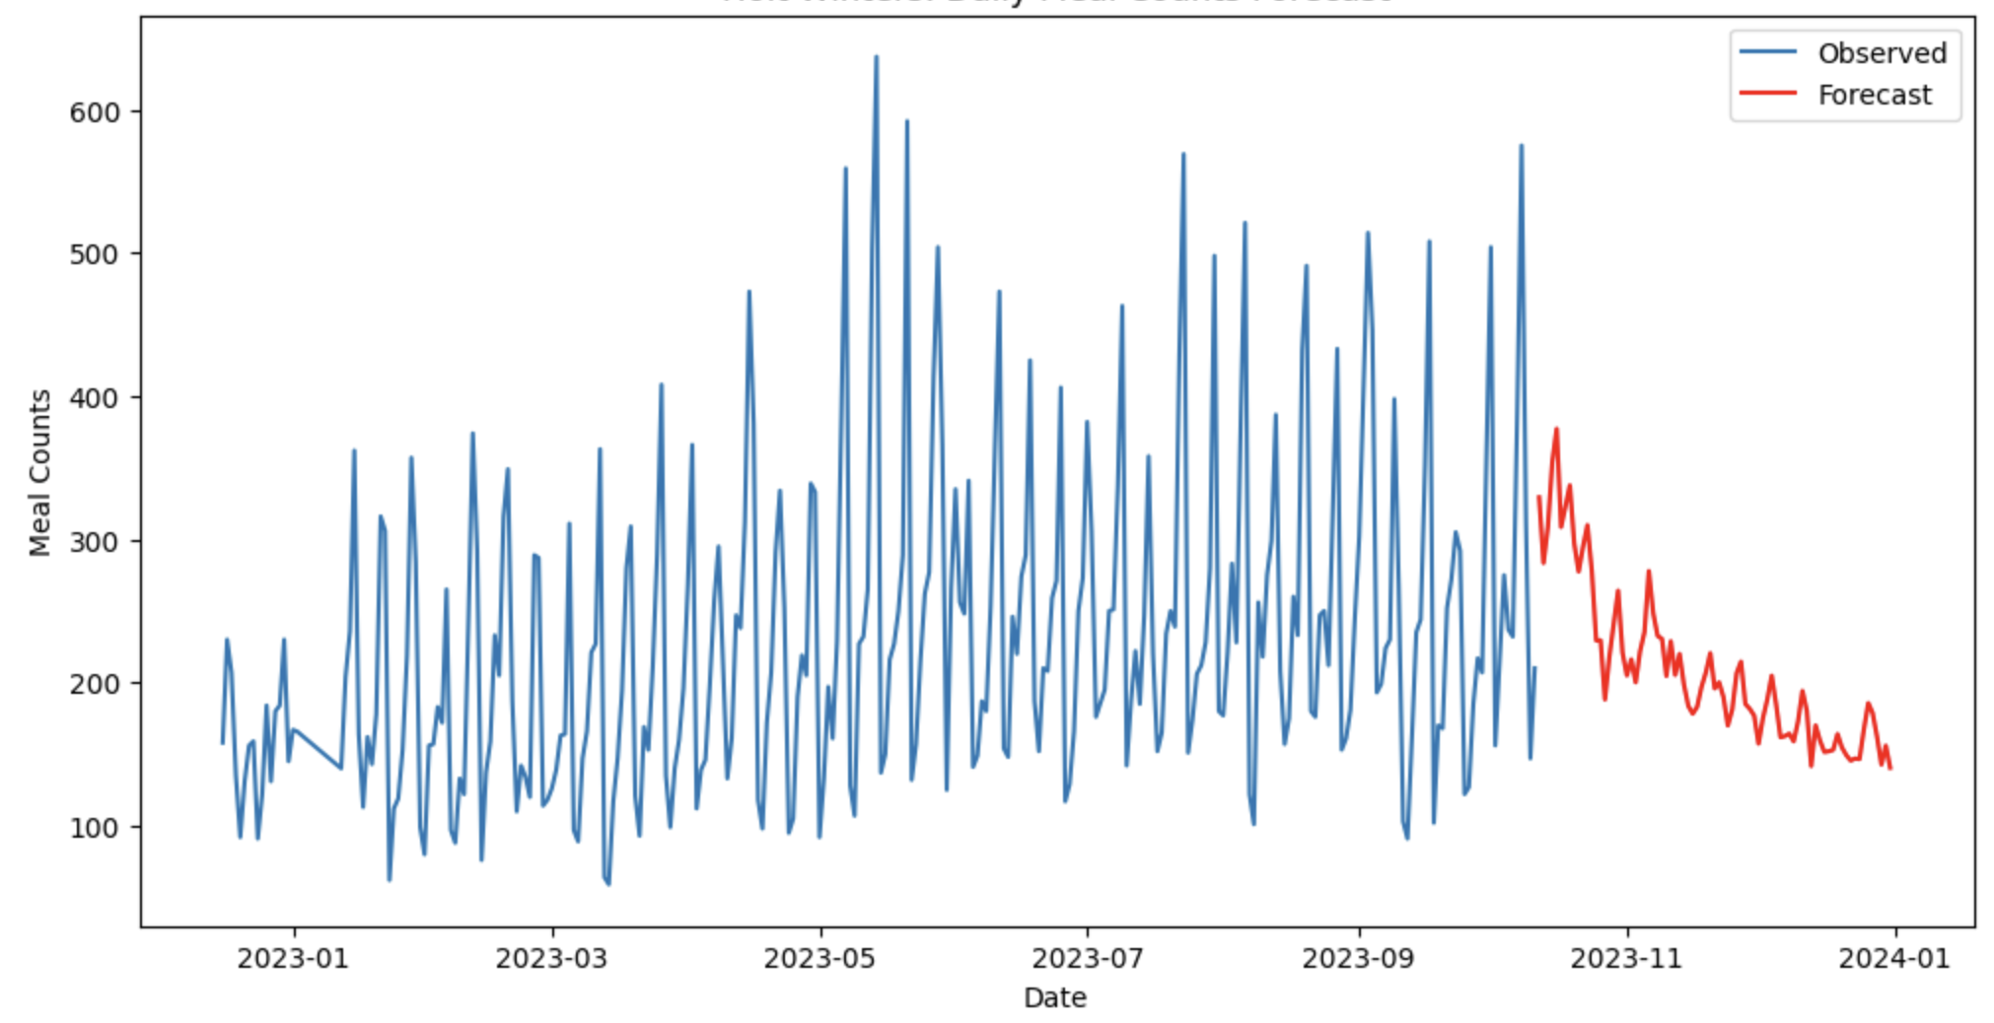
3.2. Modeling → Exponential Smoothing (Holt-Winters Method)
MAPE 0.4205
Faculty of Computing and Data Sciences
Carmen Pelayo Fernández
Notes:
1 min

Slide 12
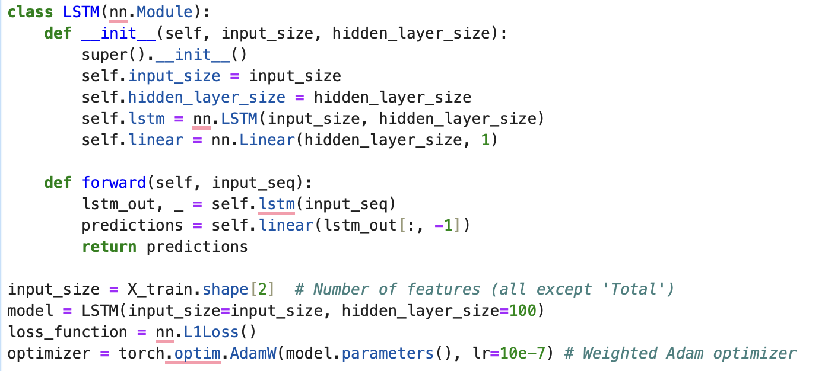
3.3. Modeling → Long Short-Term Memory (LSTM)
Faculty of Computing and Data Sciences
Carmen Pelayo Fernández
Notes:
1 min

Slide 13
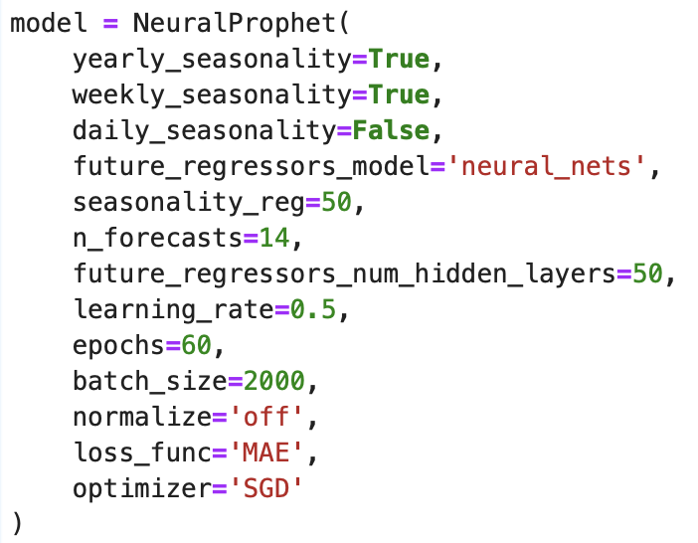
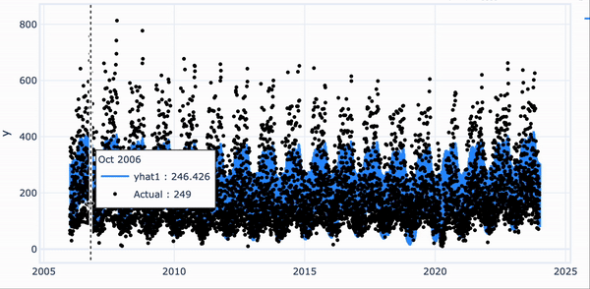
3.4. Modeling → Neural Prophet
API
Faculty of Computing and Data Sciences
Carmen Pelayo Fernández
Notes:
1 min

Slide 14
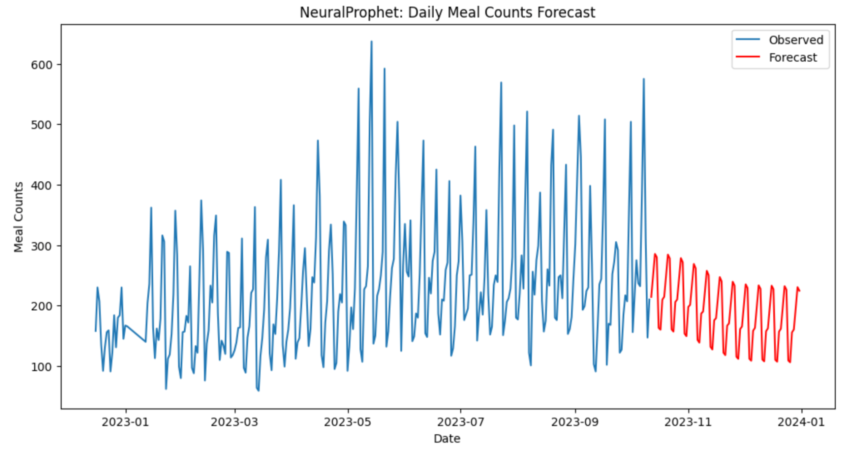
3.4. Modeling → Neural Prophet
MAPE 0.1676
Faculty of Computing and Data Sciences
Carmen Pelayo Fernández
Notes:
1 min

Slide 15
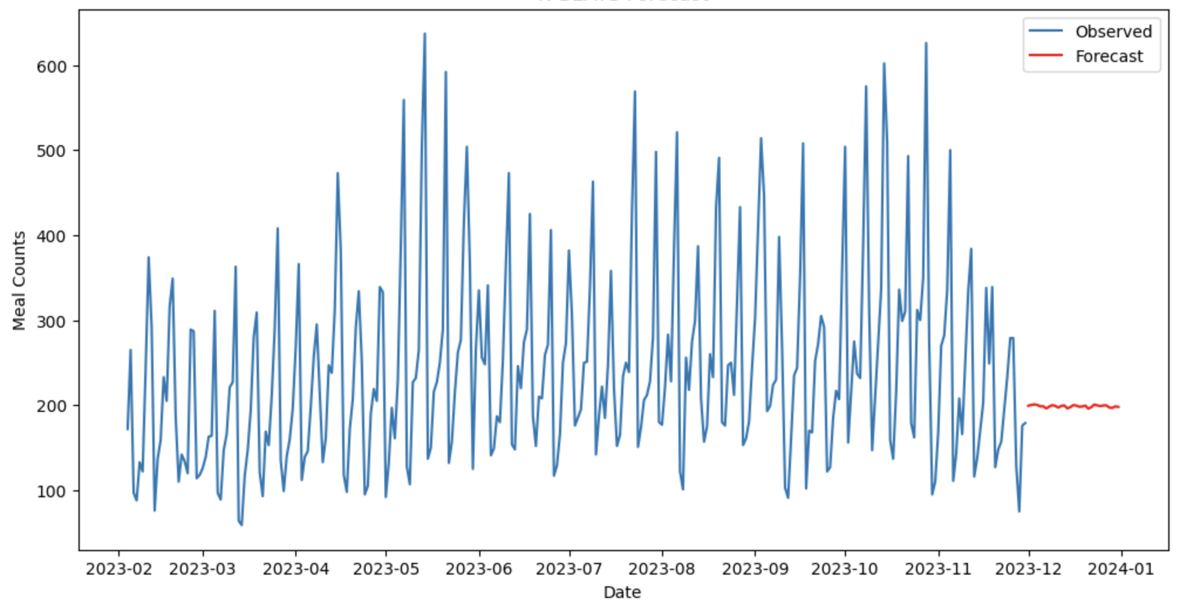
3.4. Modeling → Neural Basis Expansion Analysis Time Series (N-BEATS)
MAPE 0.2308
Faculty of Computing and Data Sciences
Carmen Pelayo Fernández
Notes:
1 min

Slide 16
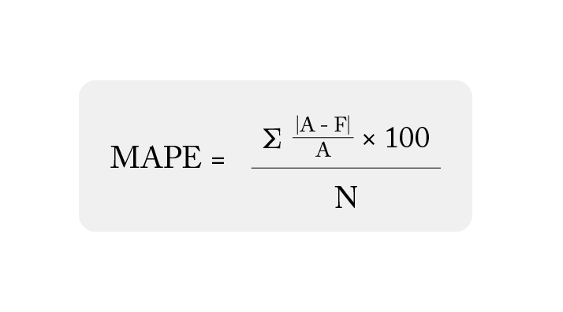
4. Results
🔎 Holdout Testing → 01/01/2006-11/30/2023 (training data) + 12/01/2023-12/31/2023 (test data).
📐 Evaluation metric = Mean Absolute Percentage Error (MAPE)
 | ARIMA | Exponential Smoothing | NeuralProphet | N-BEATS
Forecasting | Classic | Classic | Deep Learning | Deep Learning
Configuration | Order: (2,1,5) Seasonal Order: (1,1,1) [7] With intervention analysis | Trend: Additive, Seasonality: Additive, Optimizer: Powell, | Seasonality regularization: 50, Hidden layers: 50, Epochs: 60, Batch size: 2000, | Backcast Length: 7, Batch size: 2000, Hidden layers: 50, Optimizer: AdamW, Learning rate: 0.001
MAPE | 0.2837 | 0.4259 | 0.1676 | 0.2308
Faculty of Computing and Data Sciences
Carmen Pelayo Fernández
Notes:
1 min

Slide 17
Thanks!
Any Questions?
cpelayo@bu.edu
https://www.linkedin.com/in/carmenpelayofernandez/
Faculty of Computing and Data Sciences
Carmen Pelayo Fernández
Notes:
1 min

